Slide 1
Harmonization of standards- the iso 19152:2012 Ladm-family
Erik Stubkjær, Paul Scarponcini
OGC LandAdmin DWG, 21. March 2017, DelfT

Slide 2
Overview
The universe of discourse
Members of the Land Administration Domain Model family and their scope
Harmonization issues and settings for addressing them
A concern for harmonization
.. and actions to respond to it

Slide 3
The universe of discourse
LADM
Party | Owners, right holders Professionals Agencies, Land registry
Administration, RRR | Land divisions (counties..) Interest in land, ownership..
Spatial Unit | Land parcels Legal space of buildings
Surveying, Representation | Documentation, recording Geometry, topology
Surveying and software companies
Standards Developing Organizations + ..
Technology

Slide 4
Members of the LADM family
ISO 19152 Geographic Information - Land Administration Domain Model
UN-Habitat /Global Land Tool Network : Social Tenure Domain Model
LandXML → ANZLIC/ ICSM : ePlan
LandXML → OGC LandInfra DWG, LandInfra SWG :
  OGC® Land and Infrastructure Conceptual Model Standard (LandInfra)
OGC CityGML with ‘domain extensions .., which relate directly to land management and land valuation, and thus indirectly to land tenure.’(OGC 18.Feb.2016)
Notes:
ISO 19152:2012 - The Australian and New Zealand Spatial Information Council - Intergovernmental Committee on Surveying and Mapping
OGC's potential role in "Scaling up Responsible Land Governance"

Slide 5
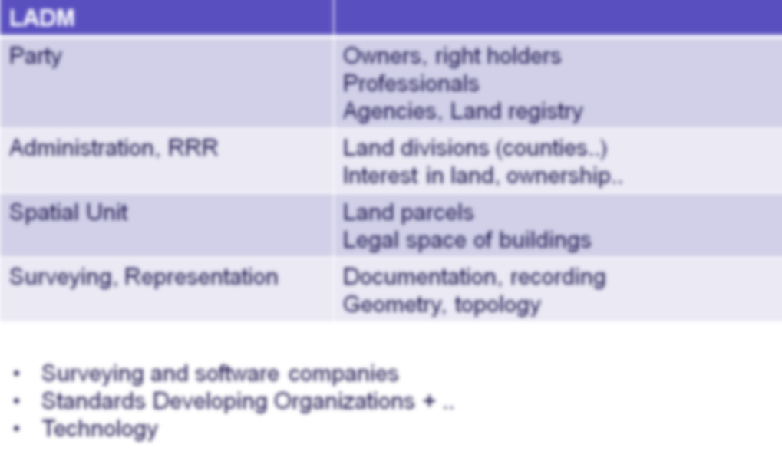
UN-Habitat /GLTN : Social Tenure Domain Model
‘The STDM is a ‘specialization’ of the ISO-approved LADM. ..’
‘The concept of the Social Tenure Domain Model is to .. .. provid[e] a standard for representing ‘people – land’ relationships independent of the level of formality, legality and technical accuracy.’ (http://stdm.gltn.net)
People
Land
Designing and Generating Documents
(from User manual)
QGIS Plug-In, …
Notes:
PostGIS/ PostgreSQL

Slide 6
ANZLIC/ ICSM : ePlan
a digital protocol for the transfer of cadastral data between the Surveying Industry and Government.
(http://www.icsm.gov.au/eplan/index.html)
2.3.2 Building Format Lot
Relative to LADM:
Various data models
..
LADM presents future prospects for digital lodgement
(3Dcadastres/workshop2011)

Slide 7
OGC LandInfra SWG / InfraGML
Scope of the LandInfra Conceptual Model is land and civil engineering infrastructure facilities.
CondominiumBuilding
SuperficieObject
SpatialUnit
BoundingElements
LandInfra developed by OGC
with buildingSMART International

Slide 8
Harmonization potentials
ISO stage code 90.20:
.. under periodical review
‘The revision process is taken up..’
UN-Habitat /GLTN:
STDM Version 1.4
QGIS Plug-In
(WB Land & Poverty 2015)
LADM
STDM
ePlan
‘It is also an explicit
goal of OSGeo to support and promote standards, including OGC standards’
(http://www.osgeo.org/faq)
LandInfra/InfraGML
15-111r1 LandInfra 2016-12-20
17-nnn InfraGML Parts 0-7 2017- -
OSGeo Community Projects
(https://wiki.osgeo.org/wiki/OSGeo_Community_Projects)

Slide 9
Harmonization: Expectations and contribution proposals
We hope that by the next conference [March 20-24 2017], the World Bank and its partners will have accomplished the following [and two other tasks]:
    A roadmap towards agreed data and interoperability standards to reduce duplication, allow sharing of land and spatial data and creation of rights layers in ways that reduce duplication, increase transparency and support evidence-based decision-making. (WB Klaus Deininger)
Proposal for OGC contributions:
  OGC informs the ISO LADM periodical review process on the new OGC LandInfra and InfraGML standards, and engages in the review process
  OGC with GLTN invite sponsor(s) for an OGC pilot project in the context of an OSGeo Community Project.
Notes:
Mandate: - to ‘promote standards’, - perform QGIS-based testing of InfraGML, and
- structuring of modules of QGIS plug-ins, to allow for joint development and yet provide applications which are fit for diverse legal/ administrative settings.

Slide 10
Erik Stubkjær & Paul Scarponcini est@land.aau.dk Paul.Scarponcini@bentley.com

