Slide 1
QGIS, Standardization, and Surveying and Documentation of Land Parcels
Erik Stubkjær
QGIS 2017 Nødebo, 3rd..Meeting, August 3.

Slide 2
My intention
World-wide, improve state building through better taxation of real property
By providing information technology which support local government tax administration
Through implementation of international standards and FLOSS applications,
specifically
Open Geospatial Consortium (OGC):
Land and Infrastructure Conceptual Model Standard (LandInfra), 2016
InfraGML encoding standards (Parts 0 to 7), 2017
and
QGIS / PostgreSQL / PostGIS

Slide 3
Why this intention? 1. Personal reasons
Incoming Head of Dept suggested (~ 2010) concern for OGC
OGC in 2012 decided to investigate LandXML. Land Development SWG established in 2013
2014 – 17 I became engaged in specification of conceptual standard (LandInfra) and corresponding encoding (InfraGML),
My background:
1977 – 2008 Professor at Aalborg University, Department of Planning. Research domain: Cadaster / Land Administration (institutional economics)
1959 – 1964 graduated as Geodetic Surveyor (Da: Landinspektør) from Royal Veterinary and Agricultural University
Occasional ‘programming’: Fortran, PDC Prolog (land parcel subdivision, topology; 1980s), html, svg, .., XAMPP, php, .. , xml, xsd, xsl transformation of examples in xml (2015-17). – GIS software not of my scientific interest

Slide 4
Overview
Personal reasons for engagement
A business case for the QGIS community: Look for state building and public administration
Standardization efforts within the domain of Land Administration
OGC: CityGML, 2008; recently also LandInfra / InfraGML
LandXML → ANZLIC/ ICSM : ePlan, 2009
ISO 2012:19152 Land Administration Domain Model (LADM)
UN-Habitat / GLTN: Social Tenure Domain Model (STDM)
buildingSMART International: Industry Foundation Classes (IFC)
Conclusion

Slide 5
2. State building, public administration, and real property
The Journal of Development Studies
Volume 52, 2016 - Issue 12: The Politics of Taxation
Domestic revenue mobilisation has received growing attention in recent years. International players such as the Organisation for Economic Co-operation and Development (OECD), the World Bank and the G20 are calling for more determined action to combat tax evasion and avoidance. Developing countries are urged to increase their own tax collection. However, implementing and sustaining tax reforms has proven to be a challenging task for many governments. This special section ….
Articles
Rebuilding Local Government Finances After Conflict: Lessons from a Property Tax Reform Programme in Post-Conflict Sierra Leone
Revenue-Maximising or Revenue-Sacrificing Government? Property Tax in Pakistan

Slide 6
2.2 State building, public administration, and real property
Building Tax Capacity in Developing Countries
The agenda for the Third International Conference on Financing for Development suggests there will be less focus on aid, and more on how developing countries can generate their own financial resources for development. Governments will be urged to tax more effectively, and donors will be called upon to help build capacity in developing country tax administrations. .. ..
Institute of Development Studies: IDS Policy Briefing, 96 ; 2015-07-05
Using Local IT Solutions to Improve Local Government Tax Reform
systems frequently favoured by donors and governments are sophisticated international systems, .. .. or tailored systems developed locally by donors themselves, which promise low cost and local appropriateness. However, international solutions are often high cost and poorly suited to local needs, while donor-led solutions risk a lack of sustainability. Using locally developed, frequently open source, private sector solutions can offer a superior option.
IDS Policy Briefing, 58; Prichard, Wilson 2014-03-25

Slide 7
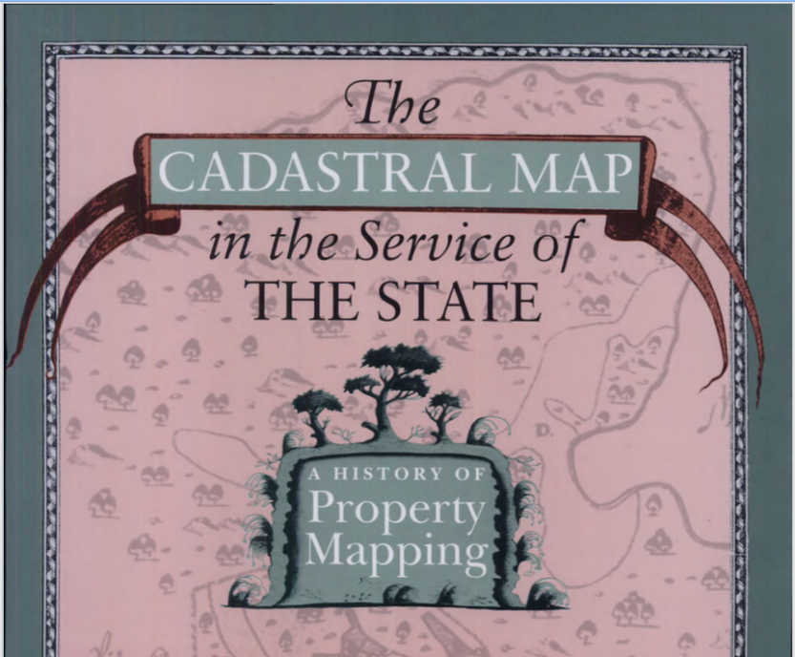
2.3 State building, public administration, and real property
Netherlands early 1600
Sweden 1600s
Milan cadaster 1760
...
intended for taxation.
USA 1700s, Land Office 1784
Australia, NZ From 1800s
intended to ‘reproduce overseas the English capitalist society’ .. ‘erasing the precapitalist indigenous settlement..’(329)
World Bank and development efforts since 1970s
are largely focused on recording of property rights,
so far not on the taxation (and spatial planning, and state building) aspects

Slide 8
3.1 Standardization: The Land Administration Domain Model
LADM conceptual schemas | LADM classes | Corresponding LandInfra classes
Party | GroupParty PartyMember | Owner, right holder Professional
Administration | RRR BAUnit AdministrativeSource | Interest in land Ownership Easement Condominium Document
SpatialUnit | SpatialUnitGroup LegalSpaceBuildingUnit | PropertyUnit LandParcel AdministrativeDivision BuildingPart
Surveying and Representation | SpatialSource MonumentationType | Statement SurveyMonument

Slide 9
3.1 Standardization: LADM and LandInfra compared
LADM
Provides a world-wide frame of reference for Land Administration
Applies a terminology, which was created by consensus within the International Federation of Surveyors, FIG
Refers to ISO 19107:2003 Geographic Information – Spatial Schema
LandInfra
Covers surveying and documentaton on location, but not the official recording of these changes
Applies legal terms from the Legal Dictionary of Property in Canada (reflecting two legal families)
Refers to GML 3.x (ISO 19136:2007), which is also an implementation of ISO 19107:2003. In addition develops on BoundingElements of SpatialUnit
Aligned with buildingSmart’s IFC

Slide 10
3.2 Standardization: Social Tenure Domain Model
‘The STDM is a ‘specialization’ of the ISO-approved LADM. ..’
‘The concept of the Social Tenure Domain Model is to .. .. provid[e] a standard for representing ‘people – land’ relationships independent of the level of formality, legality and technical accuracy.’ (http://stdm.gltn.net)
People
Land
Designing and Generating Documents
(from User manual)
QGIS Plug-In, PostgreSQL, PostGIS
Notes:
PostGIS/ PostgreSQL

Slide 11
3.3 Standardization: Harmonization potentials
ISO stage code 90.20:
.. under periodical review
‘The revision process is taken up..’
UN-Habitat /GLTN:
STDM Version 1.4
QGIS Plug-In
(WB Land & Poverty 2015)
LADM
STDM
ePlan
‘It is also an explicit
goal of OSGeo to support and promote standards, including OGC standards’
(http://www.osgeo.org/faq)
LandInfra/InfraGML
15-111r1 LandInfra 2016-12-20
17-nnn InfraGML Parts 0-7 2017- -
OSGeo Community Projects
(https://wiki.osgeo.org/wiki/OSGeo_Community_Projects)

Slide 12
5. Conclusion
World-wide, concern for recording of real property has since the 1970s focused on the individual property rights aspect
Scientific literature now points towards an alternative: Developing countries are urged to increase their own tax collection.
A research institution, the Institute of Development Studies, Brighton, UK, suggests that ‘Using locally developed, frequently open source, private sector solutions can offer a superior option’
The QGIS-community ought to consider and eventually provide such solutions
Among real property-related technical standards, LandInfra /InfraGML provides for a feasible option. Interfacing with ISO LADM and STDM seems within reach.
A project: QGIS4BoundarySurvey deserve attention and support (and being 76, I see myself as counsel, rather than head of such project)

Slide 13
Erik Stubkjær est@land.aau.dk

